Slide 1
CDD checklist
ACS8/PQM
Zhongxiao Lin

Slide 2
CDD checklist
Besides CTS/GTS, there are still some items we need to check as a CTS Lab. I’ve picked some items (which has been reported by eservice before)from GMS Requirements Document 4.0 FINAL.pdf and GMS Go Requirements.

Slide 3
CDD checklist
Check bootloader must be locked by default.
Check items | Steps
Bootloader must be locked | 1.adb reboot bootloader 2.fastboot flashing get_unlock_ability expected: (bootloader) unlock_ability = 0 (1 means bootloader is unlocked)

Slide 4
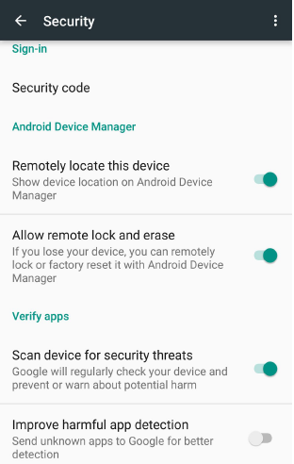
CDD checklist
Google settings/Security/ Verify apps default settings should look as below(need to sign in google account):

Slide 5
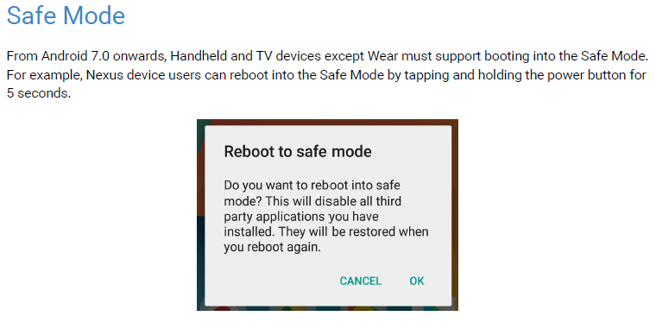
CDD checklist
Check Safe Mode
Steps: Long press power key, then long tap on “power off” item .
Expected : popup below dialog and select “OK” can go to safe mode.

Slide 6
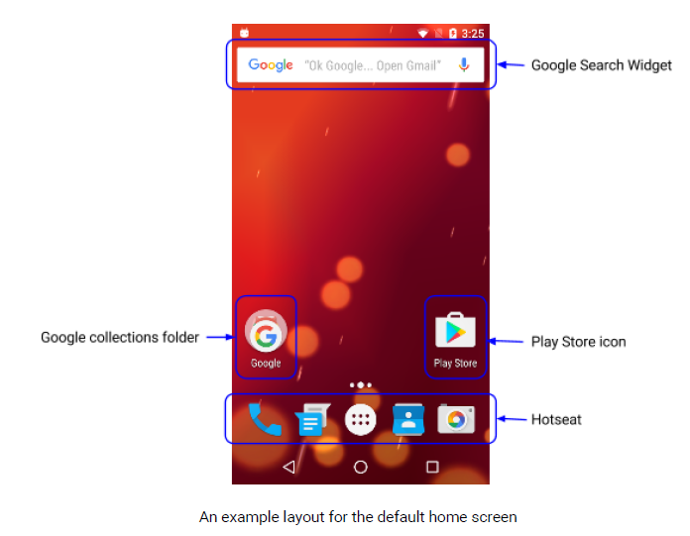
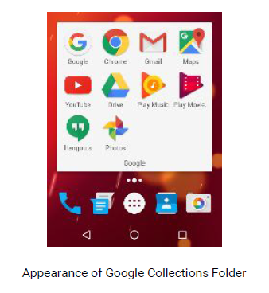
CDD checklist
For Google folder , it must:
1. Contains “Google Search, Chrome, Gmail, Maps, YouTube, Drive, Play Music, Play Movies, Duo (or Hangouts if non-telephony device), Photos ”from left to right, top to bottom.
2. Not include any non-Google apps.

Slide 7
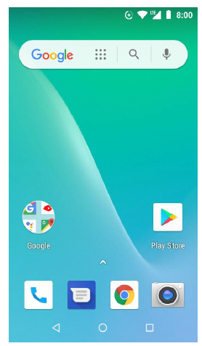
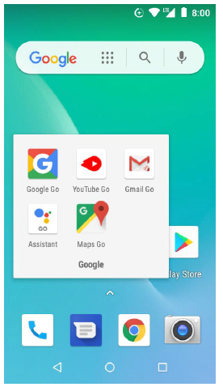
CDD checklist
For Go Edition, the Google folder must
1.Contain “Google Go, Youtube or YouTube Go, Gmail Go, Assistant Go, Maps Go” from left to right, top to bottom
2.Not include any non-Google apps.

Slide 8
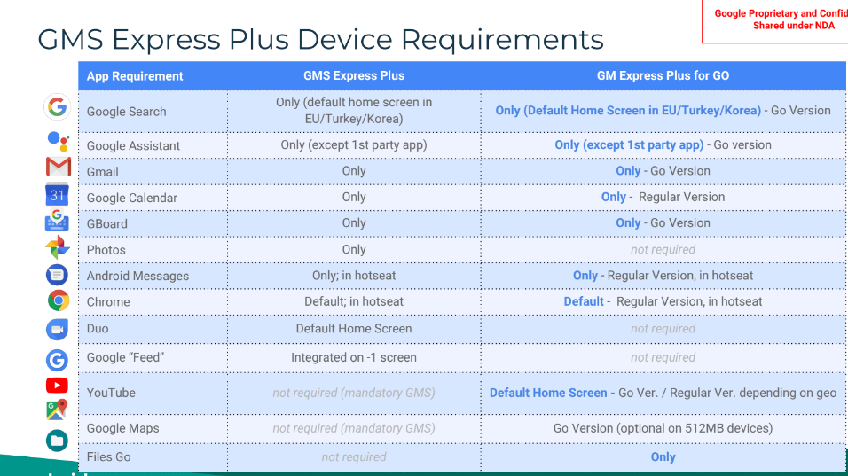
CDD checklist
For GMS EXPRESS PLUS DEVICES, Apps must follow below requirement.

Slide 9
CDD checklist
Make sure below GMS core app are preloaded (not Go edition).
NOTE: Duo is required only for Telephony devices. Non-telephony devices must preload Hangouts instead.
Google Play Store
Google Search
Chrome Browser
Google Drive
Gmail
Google Duo
Maps
Google Play Music
Google Photos
Google Play Movies
YouTube

Slide 10
CDD checklist
For Go Edition, the core app listed as below :
● Assistant Go
● Chrome
● Gmail Go
● Maps Go*
● Play Store
● Google Go
● YouTube Go / YouTube(Use Go or normal version depends on geo-availability, please refer attached table)
* Note: On 512 MB devices, Maps Go is a GMS Go Optional app

Slide 11
CDD checklist
For Android 7.x/8.x part1 (non Go edition):
App Category | Command Line(Linux) | Expected result
Browser | adb shell am start -W -a android.intent.action.VIEW -d 'https://www.wikipedia.org/' | grep -c com.android.chrome | 1
 | adb shell am start -W -a android.intent.action.VIEW -d 'http://www.wikipedia.org/' | grep -c com.android.chrome | 1
Gallery | adb shell am start -W -t image/* file://tmp/cute.jpg | grep -c com.google.android.apps.photos | 1
 | adb shell am start -W -t image/* file://tmp/cute.mp4 | grep -c com.google.android.apps.photos | 1
 | adb shell am start -W -a android.intent.action.PICK -t image/* | grep -c com.google.android.apps.photos | 1
 | adb shell am start -W -a com.android.camera.action.REVIEW -t image/* | grep -c com.google.android.apps.photos | 1
Messaging | adb shell am start -W -a android.intent.action.SENDTO -d sms:CCXXXXXXXXXX | grep -c com.google.android.apps.messaging | 1
 | adb shell am start -W -a android.intent.action.SENDTO -d smsto:CCXXXXXXXXXX | grep -c com.google.android.apps.messaging | 1
Calendar | adb shell am start -W -a android.intent.action.VIEW -d content://com.android.calendar/time/1410665898789 | grep -c com.google.android.calendar | 1 (not mandatory on Android 7.0)
*On Android 7.0 device, test for the default permission for Calendar could be skipped.

Slide 12
CDD checklist
For Android 7.x/8.x part2 (non go edition):
Email | adb shell am start -W -a android.intent.action.SENDTO -d mailto:someone@gmail.com | grep -c com.google.android.gm | 1
 | adb shell dumpsys package com.google.android.gm | grep -c "android.permission.READ_CALENDAR: granted=true" | 1
 | adb shell dumpsys package com.google.android.gm | grep -c "android.permission.WRITE_CALENDAR: granted=true" | 1
 | adb shell dumpsys package com.google.android.gm | grep -c "android.permission.READ_CONTACTS: granted=true" | 1
 | adb shell dumpsys package com.google.android.gm | grep -c "android.permission.WRITE_CONTACTS: granted=true" | 1
Keyboard | adb shell settings get secure default_input_method | grep -c com.google.android.inputmethod | 1
 | adb shell ime list -a | grep mId | grep -v -c mId=com.google.android | 0
Voice Assistant | adb shell am start -W -a android.intent.action.VOICE_COMMAND | grep -c com.google.android.googlequicksearchbox | 1
Search | adb shell am start -W -a android.intent.action.WEB_SEARCH -e query wikipedia | grep -c com.google.android.googlequicksearchbox | 1

Slide 13
CDD checklist
For Android Go edition:
App Category | Command Line(Linux) | Expected result
Browser | adb shell am start -W -a android.intent.action.VIEW -d 'https://www.wikipedia.org/' | grep -c com.android.chrome | 1
 | adb shell am start -W -a android.intent.action.VIEW -d 'http://www.wikipedia.org/' | grep -c com.android.chrome | 1
Messaging | adb shell am start -W -a android.intent.action.SENDTO -d sms:CCXXXXXXXXXX | grep -c com.google.android.apps.messaging | 1
 | adb shell am start -W -a android.intent.action.SENDTO -d smsto:CCXXXXXXXXXX | grep -c com.google.android.apps.messaging | 1
Email | adb shell am start -W -a android.intent.action.SENDTO -d mailto:someone@gmail.com | grep -c com.google.android.gm.lite | 1
 | adb shell dumpsys package com.google.android.gm.lite | grep -c "android.permission.READ_CALENDAR: granted=true" | 1
 | adb shell dumpsys package com.google.android.gm.lite | grep -c "android.permission.WRITE_CALENDAR: granted=true" | 1
 | adb shell dumpsys package com.google.android.gm.lite | grep -c "android.permission.READ_CONTACTS: granted=true" | 1
 | adb shell dumpsys package com.google.android.gm.lite | grep -c "android.permission.WRITE_CONTACTS: granted=true" | 1
Keyboard | adb shell settings get secure default_input_method | grep -c com.google.android.inputmethod | 1
 | adb shell ime list -a | grep mId | grep -v -c mId=com.google.android | 0
Voice Assistant | adb shell am start -W -a android.intent.action.ASSIST | grep -c com.google.android.apps.assistant | 1
Search | adb shell am start -W -a android.intent.action.WEB_SEARCH -e query wikipedia | grep -c com.google.android.apps.searchlite | 1

Slide 14
CDD checklist
For GMS express plus project:
the result of “adb shell pm list features” must contain “com.google.android.feature.GMSEXPRESS_PLUS_BUILD”
For Go Edition, make sure low ram property is correctly set.
[ro.config.low_ram]: [true]
For RAM equal or less than 1 GB, must use Go Edition, for RAM above 1GB, you must not use Go Edition.
For Go Edition, must provide the complete result of performance script
(it will not block GMS certification).
For latest performance script, please refer:
https://drive.google.com/open?id=1jpFsqlUT7gOJ2vcu1NIPfdFZyw3zcNLo

Slide 15
CDD checklist
For security patch date , only allow use current month or previous month patch date.
Use "getprop | grep security" to check.
For example , it is 2018 march now , hence the security date can only be "2018-03-05" or "2018-02-05".

Slide 16
CDD checklist
Make sure there is no “alps”, “Google” string in fingerprint.
Use “getprop | grep ro.build.fingerprint” to check.
Make sure the fingerprint follow this format (if not , test reports can not be uploaded to APFE):
[ro.build.brand]/[ro.product.name]/[ro.product.device]:[ro.build.version.release]/[ro.build.id]/[ro.build.version.incremental]:[ro.build.type]/[ro.build.tags]
Use “getprop | grep xxx” to get each property and compare with fingerprint.
Make sure ro.product.manufacturer is correctly set(It will display on APFE, incorrect value will be rejected by Google).
Use “getprop | grep ro.product.manufacturer” to check.
Make sure GMS version meet Google requirement(please refer the GMS device certification calendar: https://sites.google.com/a/google.com/gms-3pl-certification/home)
User “getprop | grep ro.com.google.gmsversion” to check.

Slide 17
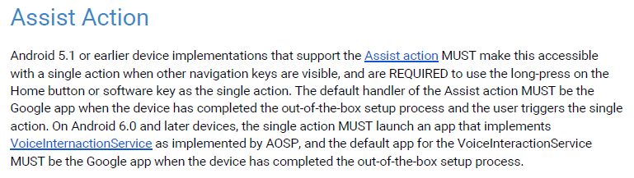
CDD checklist
Long-press on the Home button should launch Google Search app or Google Assistant.

Slide 18
CDD checklist
Check client ID
Enter adb shell first, use “getprop | grep clientid” to display all client id properties.
If it is an Operator device, make sure the properties should meet the requirement in attached Excel table.
For example, If it is not Operator device, it should only appear one clientid property, like:
[ro.com.google.clientidbase]: [android-together]
If you found other properties, it is wrong ,because the 4 property in red are already abandoned, need to remove otherwise you cannot upload the reports to APFE:
[ro.com.google.clientidbase]: [android-together]
[ro.com.google.clientidbase.am]: [android-together]
[ro.com.google.clientidbase.gmm]: [android-together]
[ro.com.google.clientidbase.ms]: [android-together]
[ro.com.google.clientidbase.yt]: [android-together]

Slide 19
CDD checklist
Check the 3PL MADA license and sublicense not overdue.
Please help to refer：
https://docs.google.com/spreadsheets/d/138uFR3merN4vYxUGEHTqOsAwal2gBmICfTFP8Zzvv1Y/edit#gid=0

Slide 20
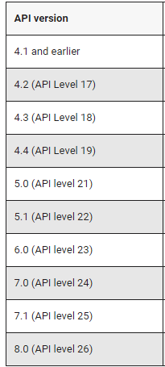
CDD checklist
If device is first launched, make sure there is no "ro.product.first_api_level"property.
use "adb shell getprop" command to check(Or enter adb shell first,then use "getprop | grep first_api_level" to check).
For upgrade build, partner must specify the correct value of ro.product.first_api_level. (refer the picture on the right)

Slide 21
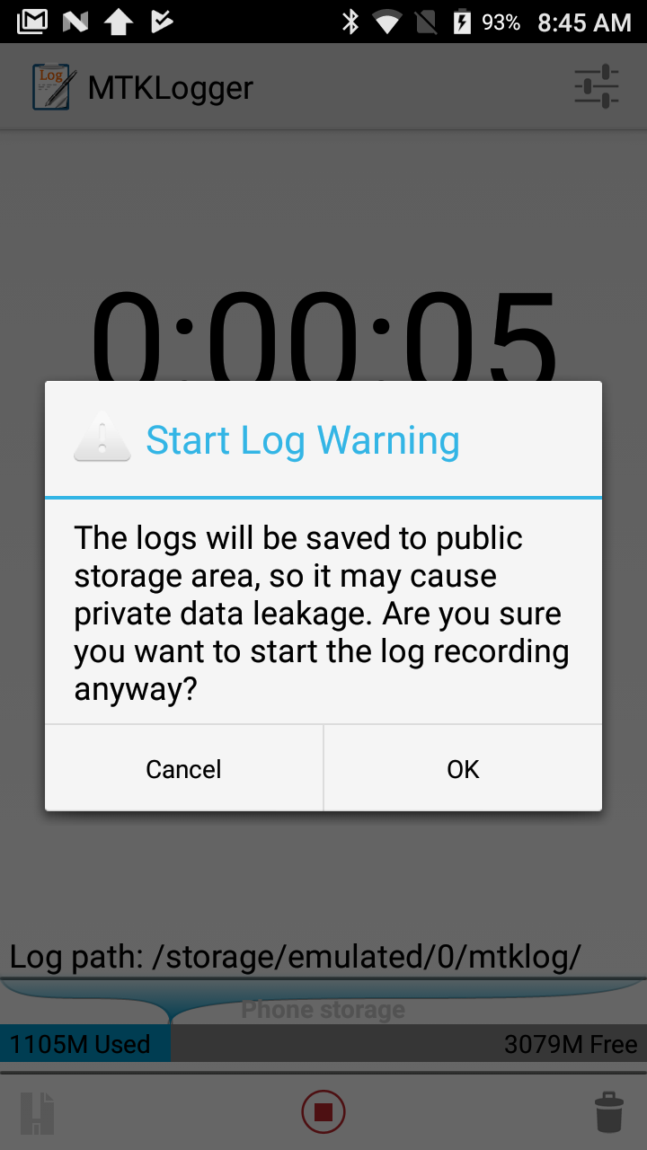
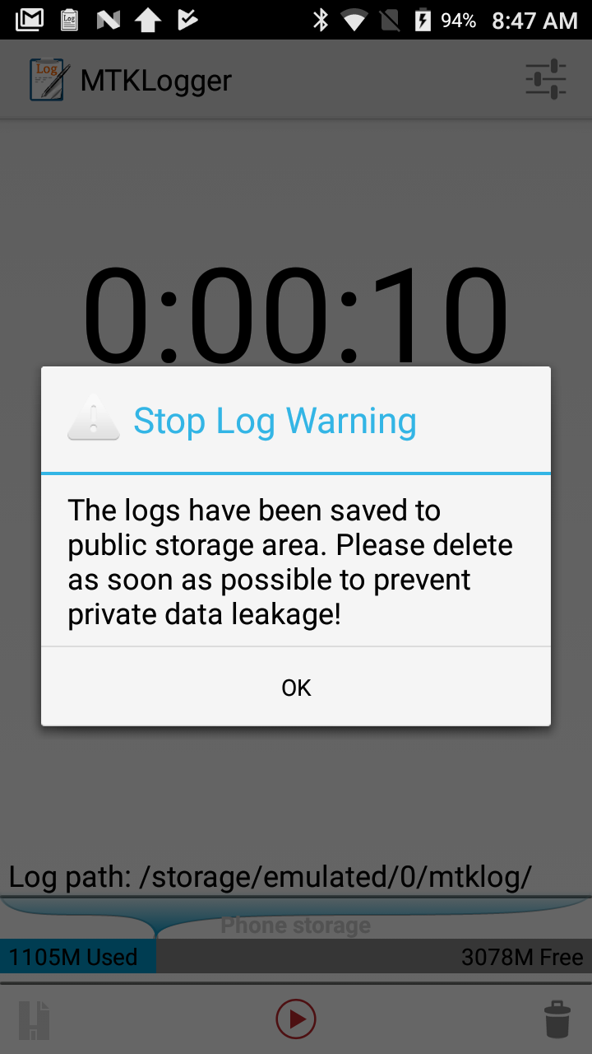
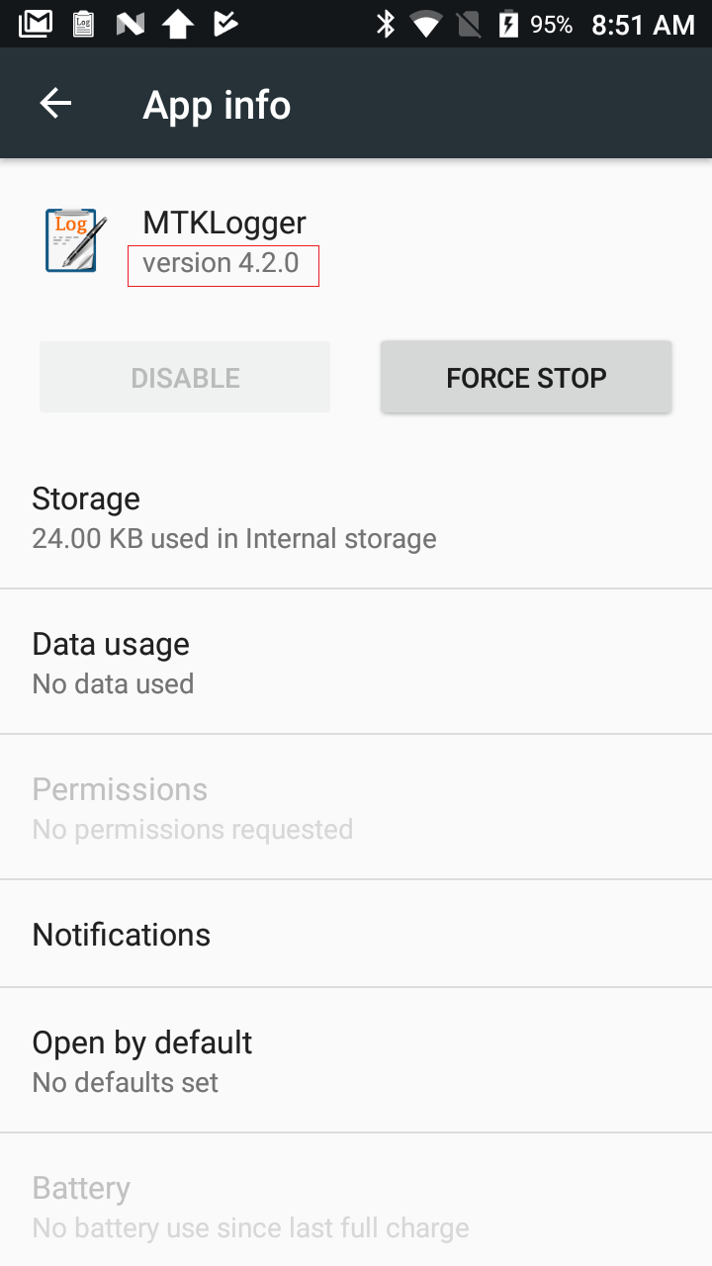
CDD checklist
If MTKLogger exists,it must meet below requirement.
1.when start recording , prompt such dialog in figure1.(You can use “adb shell am start com.mediatek.mtklogger/.MainActivity” to launch MTKLogger)
2.when stop recording ,prompt such dialog in figure2.
3.the version must >=4.2.0(settings/apps/Show system/select MTKLogger)

Slide 23
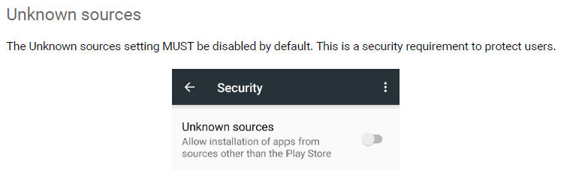
Appendix
no need to check this item because there is already a CTS testcase for it.

Slide 24
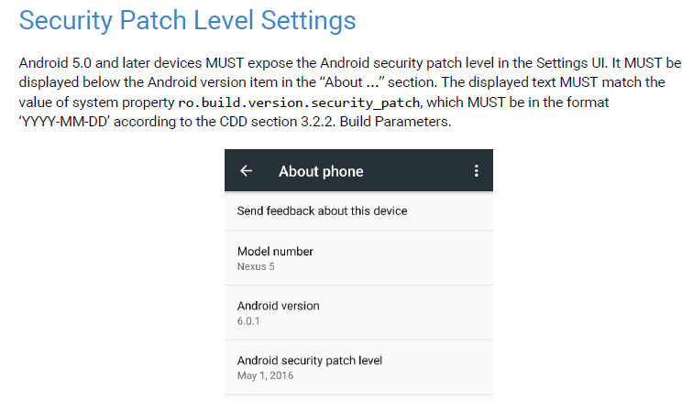
Appendix
no need to check this item because there is already a CTS testcase for it.

Slide 25
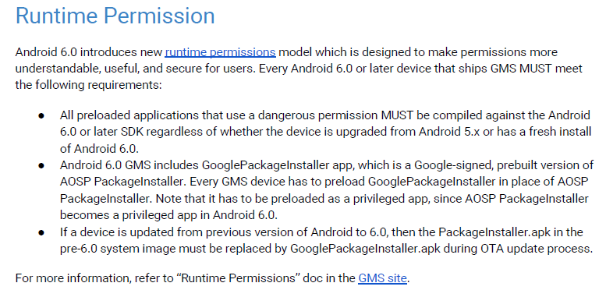
Appendix
no need to check this item because there is already a CTS testcase for it.

Slide 26
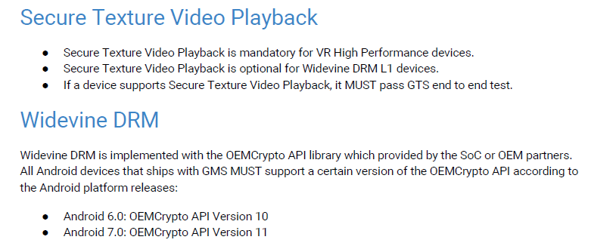
Appendix
no need to check these 2 items because there are already GTS testcases for them.

Slide 27
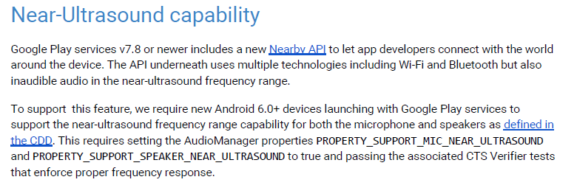
Appendix
no need to check this item because there are already CTS verifier testcases for it.

